Slide 1

College Preparatory
Senior Orientation

Slide 2


Senior Students
Mr. Corrado
A-C
Miss Hyduk
D-He
Mrs. Chegwidden
Hi-M
Mrs. Davis
N-R
Mrs. Turse
S-Z

Slide 3


Responsibilities
Assuring all credit requirements are met for high school to graduate.
Obtaining 28 credits
4 Mathematics, 4 English/ELD, 4 Social Studies, 4 Sciences, 2 PE
& 10 Electives/Languages
ACT 158
Making sure you meet the requirements for the college and deadlines.
Apply as early as possible.
Some colleges will expect at least 2-3 years of a language on your transcript.

Slide 4
Graduation Requirements
Act 158 of 2018 (Act 158), which was signed into law by Governor Tom Wolf on October 24, 2018, shifts Pennsylvania’s reliance on high stakes testing as a graduation requirement to provide alternatives for high school students to demonstrate readiness for postsecondary success.
Formerly, Pennsylvania’s statewide graduation requirement was more restrictive, requiring most students to pass the Keystone Exams — end of course exams in Algebra I, Literature, and Biology — in order to graduate.

Slide 5
Graduation Requirements Act 158
Proficient or Advanced on all
If not, there will be an evidence based or Alternative pathway for you in order to graduate.
Mid- Nov there will be a meeting with those who did not meet the criteria.
If you believe you could be one of the students who did not test at least proficient plan on attending the ACT 158 presentation in November to see what you need to complete.

Slide 6
Act 158 Evidence Based or Alternative Pathways
Take SAT, ACT
Apply to post secondary school.
Take the ASVAB (Armed Services Vocational Aptitude Battery)
Collect service hours with an adult supervisor in the community.

Slide 7


Unsure what to major in?
www.choices360.com
Interest survey
Hundreds of careers
Hundreds of colleges, universities, trade schools, and technical schools
Onet is another great tool for searching for careers

Slide 8
4 YR College
2 YR College
LEAD TO
LEAD TO
Bachelor
Master
Doctoral
Associate
Certificate
Community Colleges offer 2-year associates to transfer to a college to earn a bachelor's.
Also, offers certificates for a careers that are affordable. SAT usually not required.
Liberal Arts College
Literature, History, Languages, Math and Life Sciences. Most are private and may cost more.
Universities are larger and offer more majors and degrees.
Most contain smaller colleges, such as:
Colleges of Liberal Arts, Engineering or Health Sciences.
Vocational-Technical and Career Colleges offer specialized training in a particular industry.
Example: Culinary, Firefighting, Dental Hygiene and Medical-Records. Usually offer certificates or associate degrees.

Slide 9
Resources for Applications
Guidance webpage
www.collegeboard.com
www.commonapp.org
Any school’s official website (“edu.” will be at the end of a school’s web address).

Slide 10

G o o d N e w s
Some schools may waive the SAT but not all.
You could find out from viewing their website or by calling their admissions office
If they are waiving it, and you already taken the SAT, you do not need to send your scores
If the school is waiving the SAT and/or you are not sending SAT scores- you would apply by selecting ‘Test Optional’

Slide 11
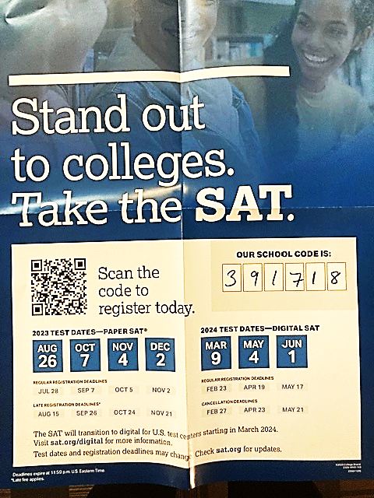
2023-24 SAT Administration Dates and Deadlines

Slide 12

Sending SAT Scores to Colleges
Using Your Collegeboard Account
On your dashboard, you'll see your latest scores front and center: Then, click on the "View Details" button to see your full report. At the top of the report, there are four tabs: Click on the "Score Sends" tab to get to a screen with a button that says "Send Additional Score Reports," and click on that button

Slide 13

Can you submit SAT scores after applying?
Yes, the scores will be accepted and considered as long as they arrive during the evaluation period.
Assuming that your scores are missing, and that you are not sending in a second set of scores, many schools that require SAT scores will not evaluate your application until the application is complete.

Slide 14
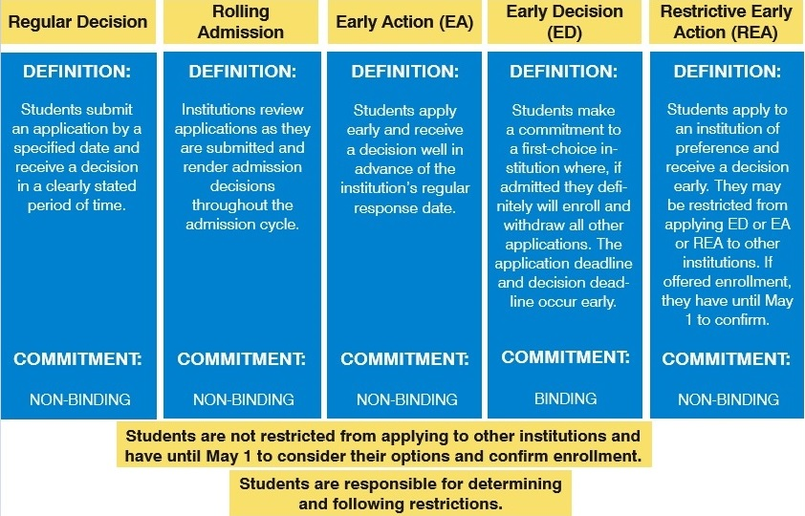

Slide 15
College Visits occur in our building
College representative visits are for interested juniors and seniors who like to learn more about a certain college by obtaining firsthand information by an admissions representative.
The following representatives will be visiting our school →
November:
2nd 9:30 am Cedar Crest College
3rd 1:00 pm Kutztown University
9th 12:00 pm Alvernia
13th 9:30am LCCC (Instant Decision)

Slide 16

Upcoming College Visits:
October:
26th 9:00 am Penn State Hazleton
26th 1:00 pm University of Pittsburgh
27th 9:30 am Susquehanna University
31st 10:15 am Muhlenberg College
November:
2nd 9:30 am Cedar Crest College
3rd 9:30 am SUNY- State University of New York
1:00 pm Kutztown University
7th 9:30 am York College of PA
8th 9:30 am PA College of Technology
9th 12:00 pm Alvernia
13th 9:30 am Moravian University
9:30 am LCCC (Instant Decision Day)
14th 9:30 am Shippensburg University
15th 9:30 am Ithica College
16th 9:30 am SUNY- Oneonta Campus
17th 9:30 am Wilkes University
28th 9:30 am East Stroudsburg University

Slide 17
Are you interested in the military?
ASVAB Testing
Any 10th - 12th grade student interested in joining the military will need to take the Armed Services Vocational Aptitude Battery, the ASVAB Exam.
The ASVAB exam date is TBD
There should be another testing in the spring if you missed the October test.

Slide 18

ASVAB – MILITARY TEST ENTRANCE
What's tested on the ASVAB?
The Armed Services Vocational Aptitude Battery, is an aptitude test administered by the United States Military Entrance Processing Command.
Why take the ASVAB in high school?
The ASVAB serves as a useful tool to let a high school student and their families make an educated decision on how to proceed with formal education beyond the senior year.

Slide 19


State and Federal Aid
You can apply for PHEAA (State) and Pell (US Govt) Grants in December ? 2023.
Create a FSA ID. You can do this before applying for FAFSA. Having this ID is the only way to access your data online. (You and a parent/guardian will need a FSA ID).
Acquire your FAFSA application and FSA ID on: https://studentaid.gov/
If you are an 18 yr old male you must register for selective service to receive any financial aid.

Slide 20
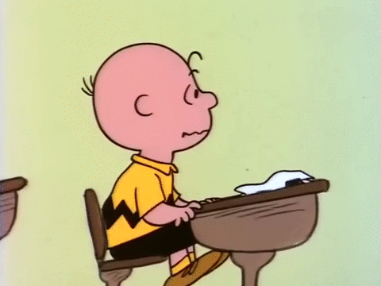
Side Notes
The FAFSA determines if you qualify for Federal money
(The Federal Pell Grant)
Pell Grant - max award $7,395 (2023-24) - Eligibility is the same for every postsecondary institution
After you do the FAFSA you will be redirected to complete the PA State Grant.
PA State Grant Program
In-state – max award $5,750 (fulltime)-(2023-24)
This is money you do not payback, ever.

Slide 21
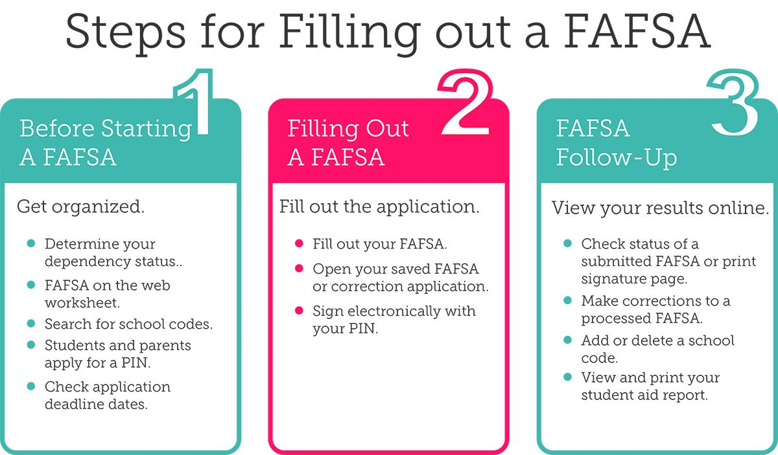
YOU WILL NEED YOUR FAMILIES 2022 W2 TAX STATEMENTS

Slide 22
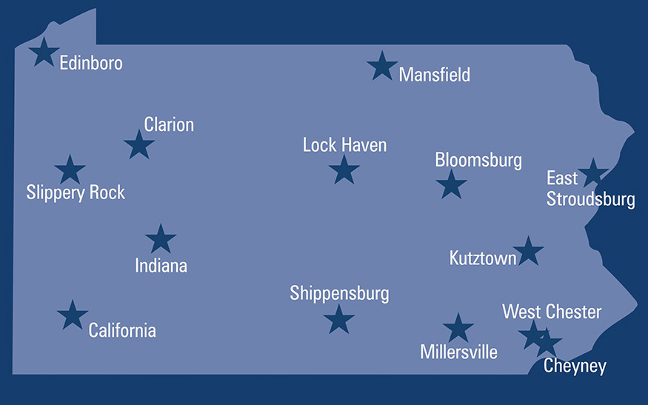
List of state schools
BLOOMSBURG UNIVERSITY
CALIFORNIA UNIVERSITY
CHEYNEY UNIVERSITY
CLARION UNIVERSITY
EAST STROUDSBURG UNIVERSITY
EDINBORO UNIVERSITY
INDIANA UNIVERSITY
KUTZTOWN UNIVERSITY
LOCK HAVEN UNIVERSITY
MANSFIELD UNIVERSITY
MILLERSVILLE UNIVERSITY
SHIPPENSBURG UNIVERSITY
SLIPPERY ROCK UNIVERSITY
WEST CHESTER UNIVERSITY

Slide 23
Personal Email
Do not use your high school email when entering an email for college applications and the FAFSA.
Your incoming messages may be blocked by our school, since it would be an outside email.
You should use a personal email that you check frequently.
Make it formal.

Slide 24



$cholarships
Listen for announcements
www.fastweb.com
www.choices360.com
www.questbridge.org
Guidance office
Standard Speaker
HAHS website
https://www.hasdk12.org/Page/26433

Slide 25
Any Questions!

